Slide 1
Module 1 (9 Hours)
Introduction to data science, Data science classification, Data science process - Prior knowledge, Data preparation, Modelling, Application, Data exploration - Data sets, Descriptive statistics for univariate and multivariate data
Data visualization – Histogram, Quartile plot, Distribution chart, Scatter plot, Bubble chart, Density chart

Slide 2
Introduction to Data Science

Slide 3
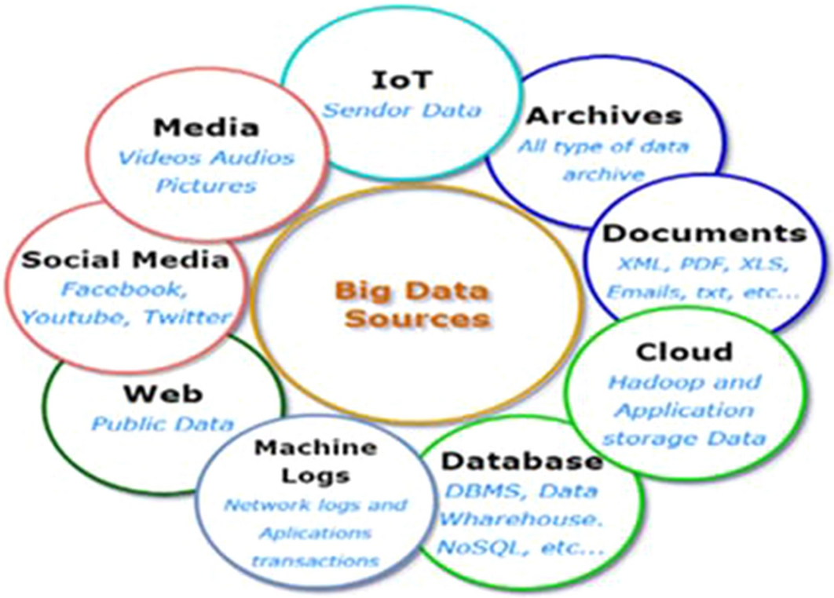

Slide 4
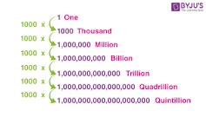

Slide 5
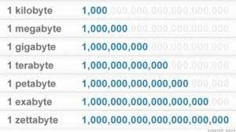

Slide 6
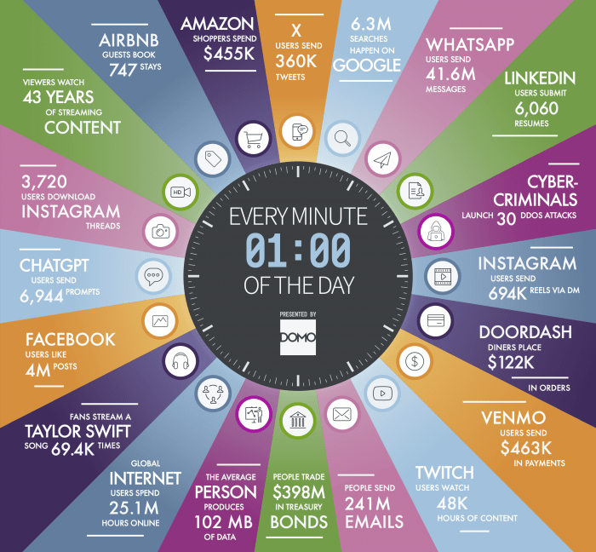

Slide 7
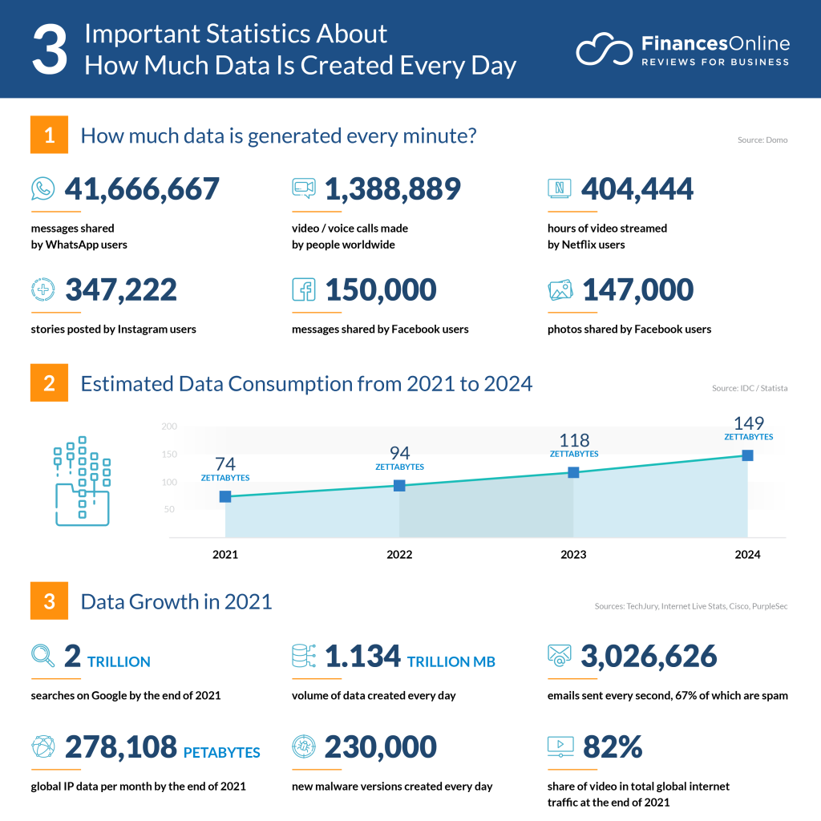

Slide 9
There are currently over 120 zettabytes of data in the entire digital universe (PWC)
The amount of data created by humans grows at an exponential rate.
In 2019, there were 4.4 ZB of data in the digital universe.
In 2020, that figure increased tenfold — up to 44 ZB.
Just how much is a zettabyte? One trillion gigabytes.

Slide 10
Big Data Statistics 2024
Around 2.5 quintillion bytes of data are generated each Day.
Google gets more than 9 Billion searches per day.
WhatsApp users exchange over 100 Billion Messages daily.
More than 231 million emails are sent.
Around 500 hours of videos are uploaded on YouTube.
Instagram users share around 66,000 photos.
1.7 million content pieces are shared on Facebook.
More than 4.3 million Snaps are sent on Snapchat.
16 million text messages are sent.
More than $443,000 is spent by consumers on Amazon.
Around 347,200 tweets are tweeted on Twitter.

Slide 11
Big Data Statistics 2024
Over 120 professionals join LinkedIn every day.
By 2025, there would be 75 billion Internet-of-Things (IoT) devices in the world.
The volume of data created worldwide is expected to reach 181 zettabytes by the end of 2025.
To download all the data on the internet, an internet user will need approximately 180 million years.
Over 80 Percent of data generated today is unstructured.
95% of businesses said that managing unstructured data is a significant problem.

Slide 12
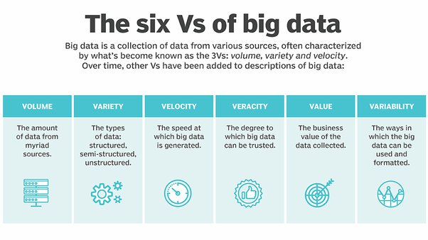

Slide 13
Science
systematic study of the structure and behaviour….
the intellectual and practical activity encompassing the systematic study of the structure and behaviour of the physical and natural world through observation and experiment. (Oxford)
Science is a systematic enterprise that builds and organizes knowledge in the form of testable explanations and predictions about……

Slide 14
Data Science
Data science is the field of study that combines domain expertise, programming skills, and knowledge of mathematics and statistics to extract meaningful insights from data.
Data science is an interdisciplinary field that uses scientific methods, processes, algorithms and systems to extract knowledge and insights from noisy, structured and unstructured data, and apply knowledge from data across a broad range of application domains.
Data science is the domain of study that deals with vast volumes of data using modern tools and techniques to find unseen patterns, derive meaningful information, and make business decisions.

Slide 15
Data science is a collection of techniques used to extract value from data.
That collects, stores, and processes data as part of its operations.
To find useful patterns, connections, and relationships within data.
Data Science - Knowledge Discovery, Machine Learning, Predictive Analytics, Data Mining...

Slide 16
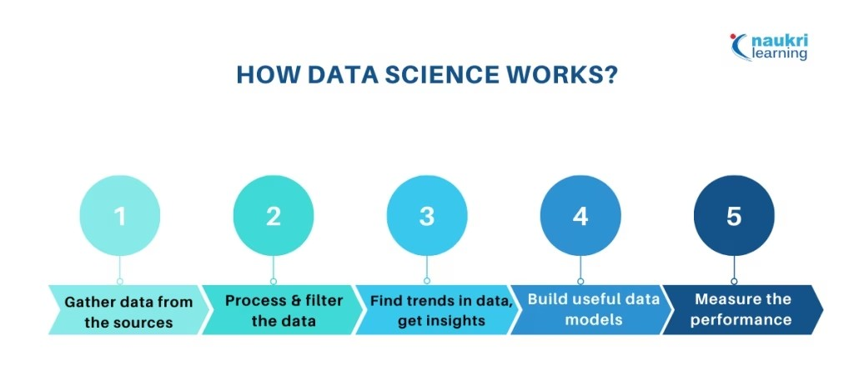

Slide 17
AI – ML - DS
Artificial Intelligence
Giving machines the capability of mimicking human behavior, particularly cognitive functions.
Examples: Facial Recognition, Automated Driving, Robots…
Areas: Linguistics, NLP, Decision Science, Vision, Robotics…
Machine learning can either be considered a sub-field or one of the tools of artificial intelligence, is providing machines with the capability of learning from experience

Slide 18
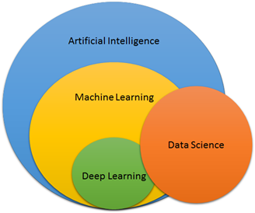

Slide 19
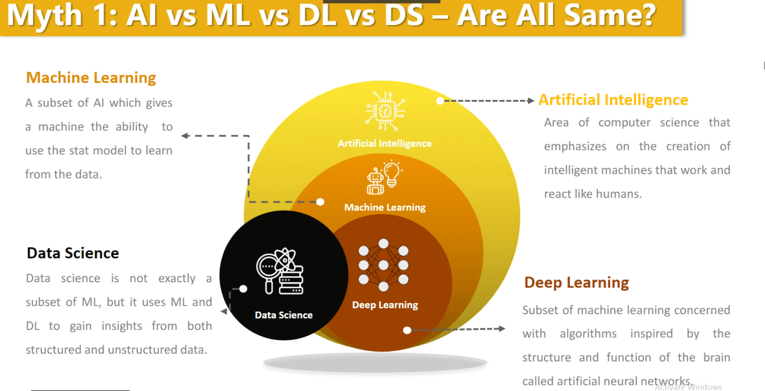

Slide 20
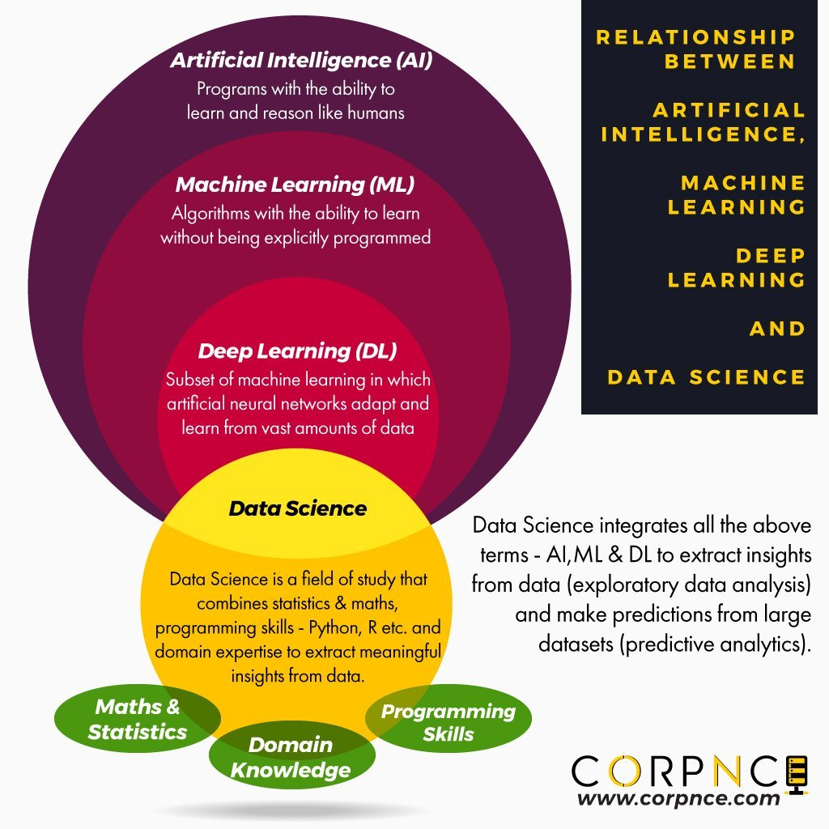

Slide 21
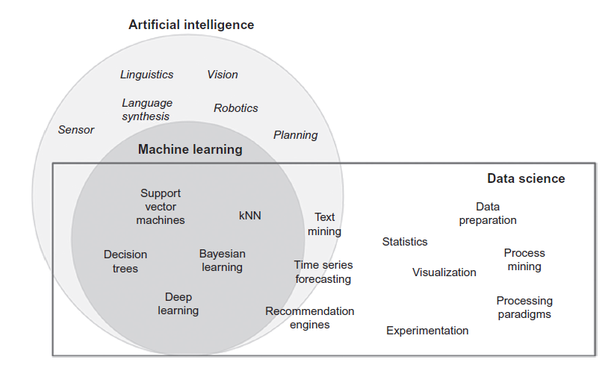

Slide 22
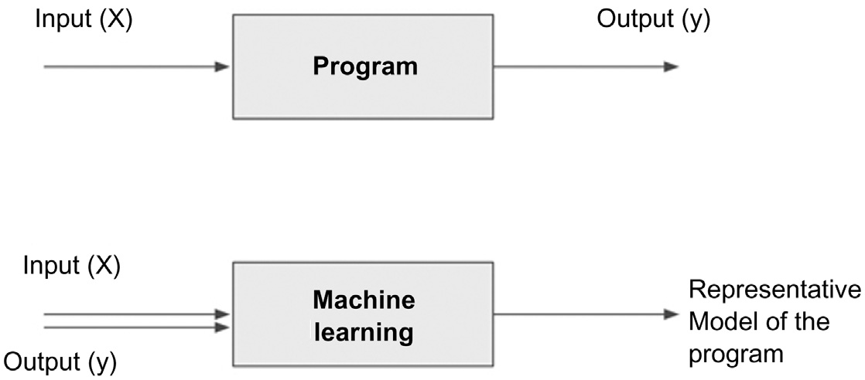
Traditional program and machine learning

Slide 23
WHAT IS DATA SCIENCE?
Data science is the business application of machine learning, artificial intelligence, and other quantitative fields like statistics, visualization, and mathematics.
It is an interdisciplinary field that extracts value from data.
Examples
Recommendation Engines
Fraud Alert model that detects fraudulent credit card transactions
Find customers who will most likely churn next month
Predict revenue for the next quarter …

Slide 24
Data : A simple array of a few numeric observations to a complex matrix of millions of observations with thousands of variables.
Data science: Utilizes certain specialized computational methods (algorithms) in order to discover meaningful and useful structures within a dataset.

Slide 25
Features of Data Science
Extract Meaningful Patterns
Build Representative Models
Combination Statistics, ML & Computing
Learning Algorithms

Slide 26
Build Representative Models

Slide 27
Fields associated with Data Science
Descriptive Statistics
Exploratory Visualization
Dimensional Slicing
Hypothesis Testing
Data Engineering
Business Intelligence

Slide 28
Machine Learning
Supervised Learning
Unsupervised Learning
Reinforcement Learning

Slide 29
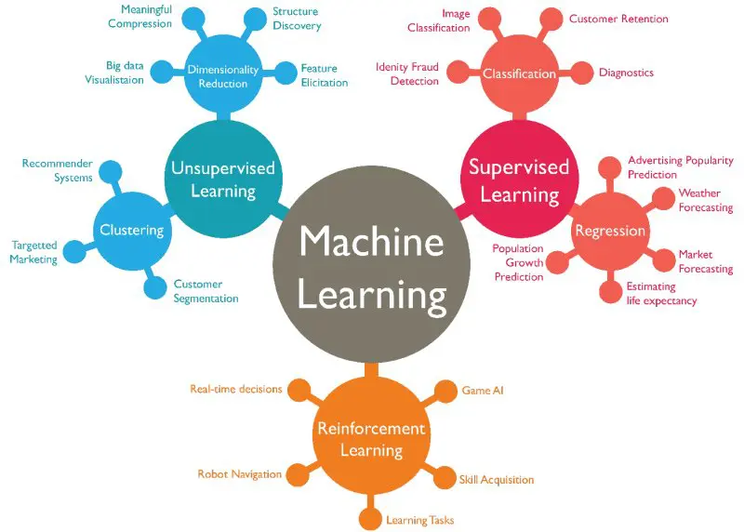

Slide 30
DATA SCIENCE CLASSIFICATION

Slide 31
Data Science Tasks

Slide 32
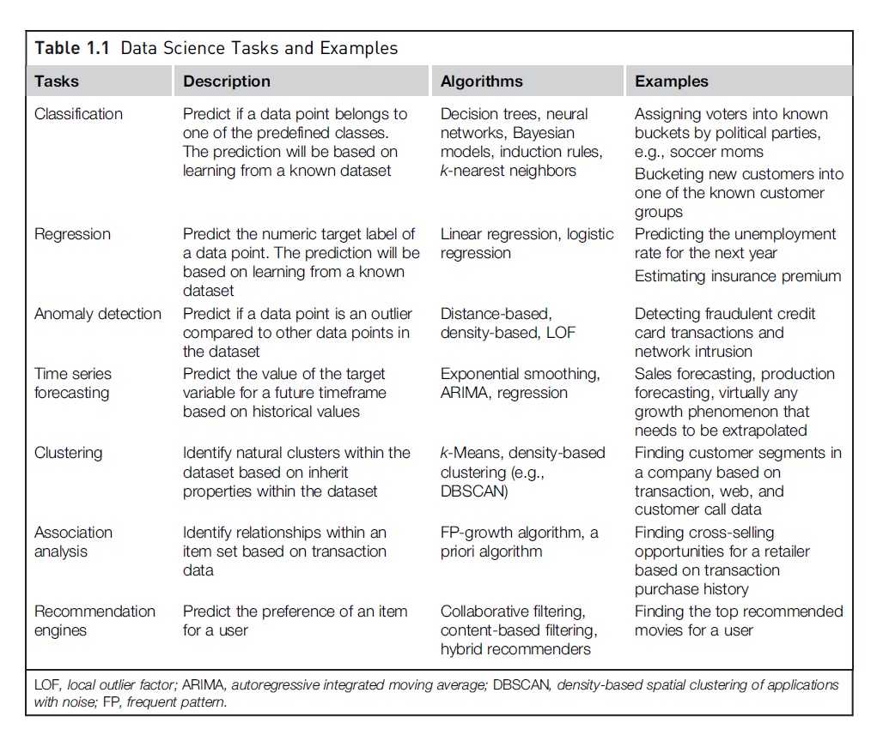

Slide 33
Data Science Process

Slide 34
Data Science Process
Methodical discovery of useful relationships and patterns in data - Iterative activities - collectively known as the data science process.
Understanding the problem
Preparing the data samples
Developing the model
Applying the model on a dataset to see how the model may work in the real world
Deploying and maintaining the models

Slide 35
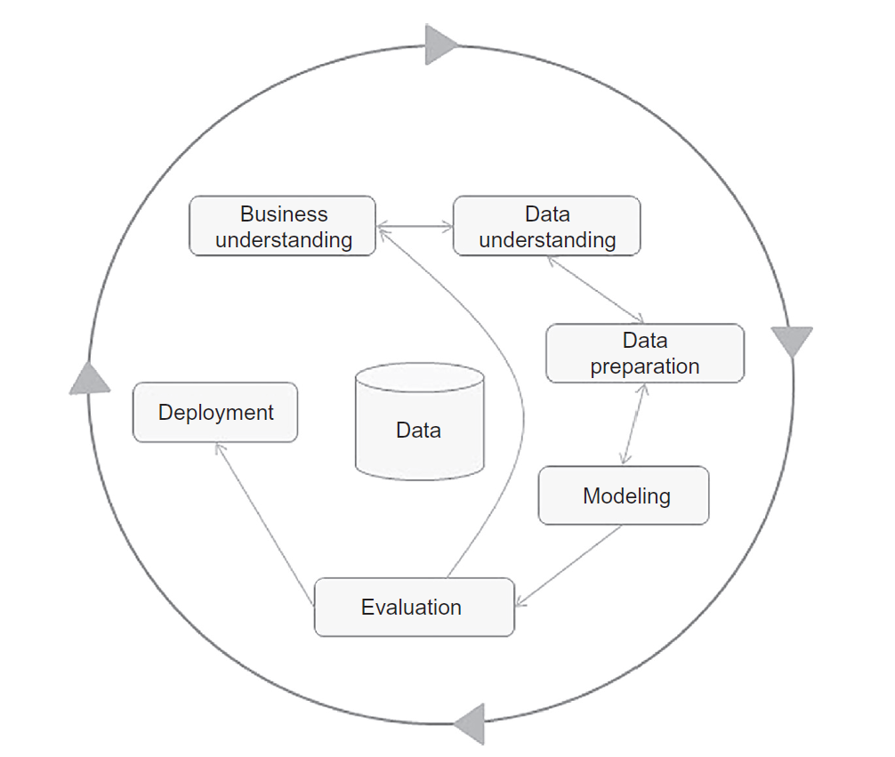
CRISP-DM Framework

Slide 36
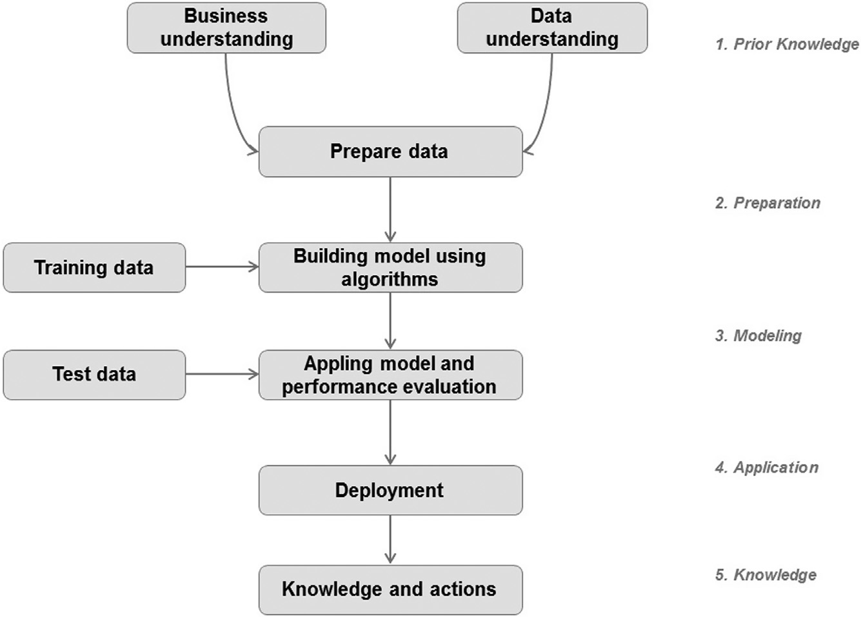
Data Science Process

Slide 37
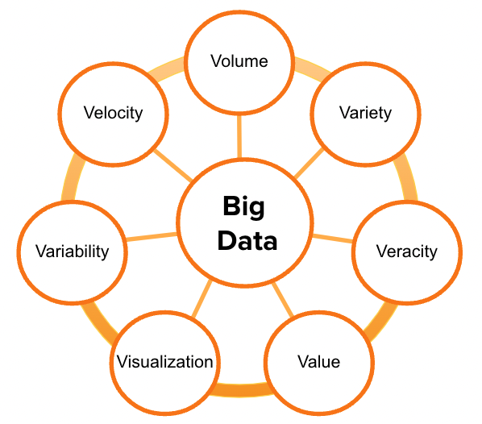
Prior Knowledge
Objective
Subjective
Data
Quality of the data
Quantity of data
Availability of data
Gaps in data
Does lack of data compel the practitioner to change the business question
…

Slide 38
Data Terminologies
Dataset
Data point
Attribute
Label
Identifiers
Causation / Correlation
The correlation between the input and output attributes doesn’t guarantee causation.

Slide 39
2.DATA PREPARATION
Data Preparation
Data Exploration
Data Quality
Missing Values
Data Types and Conversion
Transformation
Outliers
Feature Selection
Data Sampling

Slide 40
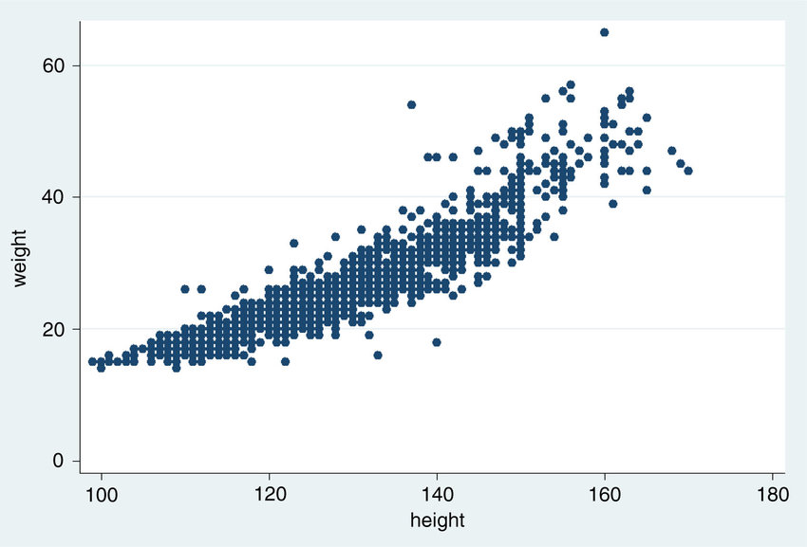
2.DATA PREPARATION
Data Preparation
Data Exploration (Exploratory data analysis)
With the help of simple tools to achieve basic understanding of the data
structure of the data
distribution of the values
presence of extreme values
inter-relationships within the dataset
Descriptive Statistics
Mean, Medium, Mode, SD, Range…
Visualization of data

Slide 41
2.DATA PREPARATION
Data Preparation
Data Quality
Accurate…?
Data entry error…?
Clean the data
Elimination of duplicate records
Quarantining outlier
Records that exceed the bounds
Standardization of attribute values
Substitution of missing values

Slide 42
2.DATA PREPARATION
Data Preparation
Missing Values
Identify the data source
Understand the reason
Mitigation methodology
Substitute with representative value
Ignore the records

Slide 43
2.DATA PREPARATION
Data Preparation
Data Types and Conversions
Data Types
Numeric
Continuous, Integer
Categorical
Category value, Numeric score
Conversions
Categorical to Numeric
Eg. Linear Regression
Numeric to Categorical
binning

Slide 44
2.DATA PREPARATION
Data Preparation
Transformation
Normalization
Outliers
Cause of occurrence
Need specific treatment

Slide 45
2.DATA PREPARATION
Data Preparation
Feature Selection
Reducing the number of attributes, without significant loss in the performance of the model, is called feature selection.
Not all the attributes are equally important
Large number of attributes in the dataset significantly increases the complexity of a model
Curse of Dimensionality
Degrade the performance of the model
Feature Selection / Dimensionality Reduction

Slide 46
2.DATA PREPARATION
Data Preparation
Data Sampling
Sampling is a process of selecting a subset of records as a representation of the original dataset for use in data analysis or modeling.
Representative dataset
Reduces the amount of data that need to be processed
Speeds up the model building process
Simple random sampling
Class label specific sampling (Stratified Sampling)

Slide 47
MODELING
A model is the abstract representation of the data and the relationship in a given dataset.
The modeling step creates a representative model inferred from the data

Slide 48
2.DATA PREPARATION
Modeling
Predictive Modelling
Classification, Regression…
Learn based on the given dataset
Descriptive (Explanatory) Modelling
Association Analysis, Clustering…
No target variable, hence no dataset

Slide 49
MODELING
Training and Testing Datasets
The dataset used to create the model, with known attributes and target, is called the training dataset.
The validity of the created model will also need to be checked with another known dataset called the validation dataset / test dataset.
To facilitate this process, the overall known dataset can be split into a training dataset and a test dataset
A standard rule of thumb is two-thirds of the data are to be used as training and one-third as a test dataset

Slide 50
MODELING
Learning Algorithms
The business question and the availability of data will determine what data science task can to be used.
Classification, Regression, Association, Clustering…
The practitioner determines the appropriate data science algorithm
Classification
Decision tree, Naïve Bayes, k-NN…
Regression
Linear, Logistic, Ridge, Random Forest, SVM…
Association
AIS, Apriori…
Clustering
k-Means, k-Mediods, DBSCAN…

Slide 51
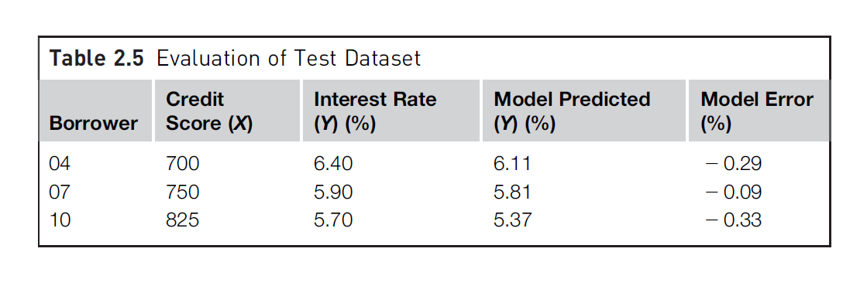
MODELING
Evaluation of the Model
Avoid overfitting
Prediction error
Training Error
Testing Error

Slide 52
MODELING
Ensemble Modeling
Multiple diverse base models are used to predict an outcome
To reduce the generalization error of the prediction
Even though the ensemble model has multiple base models within the model, it acts and performs as a single model

Slide 53
MODELING
Summary
Analyzed the business question
Sourced the data relevant to answer the question
Selected a data science technique to answer the question
Picked a data science algorithm and prepared the data to suit the algorithm
Split the data into training and test datasets
Built a generalized model from the training dataset and
Validated the model against the test

Slide 54
Application
Model deployment stage
Assessing model readiness
Technical integration
Response time
Model refresh
Assimilation

Slide 55
Knowledge
The data science process starts with prior knowledge and ends with posterior knowledge, which is the incremental insight gained
The whole data science process is not meant to be used as a set of rigid rules,
but as a set of iterative, distinct steps that helps in knowledge discovery

Slide 56
Data Science Process

Slide 57
Data Visualization

Slide 58
Visualization
Histogram
Quartile (Box) plot
Distribution chart
Scatterplot
Scatter multiple
Scatter matrix
Bubble chart
Density chart
Parallel chart
Deviation chart
Andrews curves

Slide 59
Python Libraries for Visualization
Matplotlib
Plotly
Seaborn
Bokeh

Slide 60
Exploratory Data Analysis using IRIS Dataset
https://gist.github.com/rabiulcste/33d985ab55820353181f9727a9496a81

Slide 61
Exploratory Data Analysis using Breast Cancer Dataset
https://www.kaggle.com/code/harshjain123/breast-cancer-exploratory-data-analysis
https://github.com/sara-kassani/Python-Machine-Learning-Codes/blob/master/Visualization%20-%20Breast%20Cancer%20Wisconsin%20(Diagnostic)%20Data%20Set.ipynb

